Slide 1
A few visualization links this week
Financial Times story I mentioned last week:
http://vizz.site/charts-financial-times-1.pdf
http://vizz.site/charts-financial-times-2.pdf
A discussion of visualization, transit data, and the infamous Y-axis starts at zero:
http://humantransit.org/2016/01/journalists-some-key-cautions-about-transit-articles.html

Slide 2

Exploring data sets
& data profiling
Week 4
Feb 2, 2016 (Groundhog Day)

Slide 3
Week 4 topics
Why do we explore data?
What are data exploration strategies?
A look at tools:
Tableau
Excel
Python
R

Slide 4
Why do we explore data?
Three main reasons for exploring data
Understand the ”schema”
Understand the data
Better analysis and visualization

Slide 5
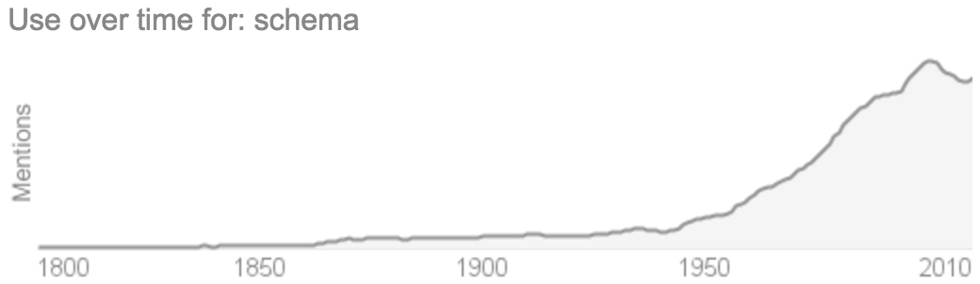
Understanding data schema
Whether it’s called:
schema
column headers
data dictionary
data structures
This how data is usually organized & managed.

Slide 6
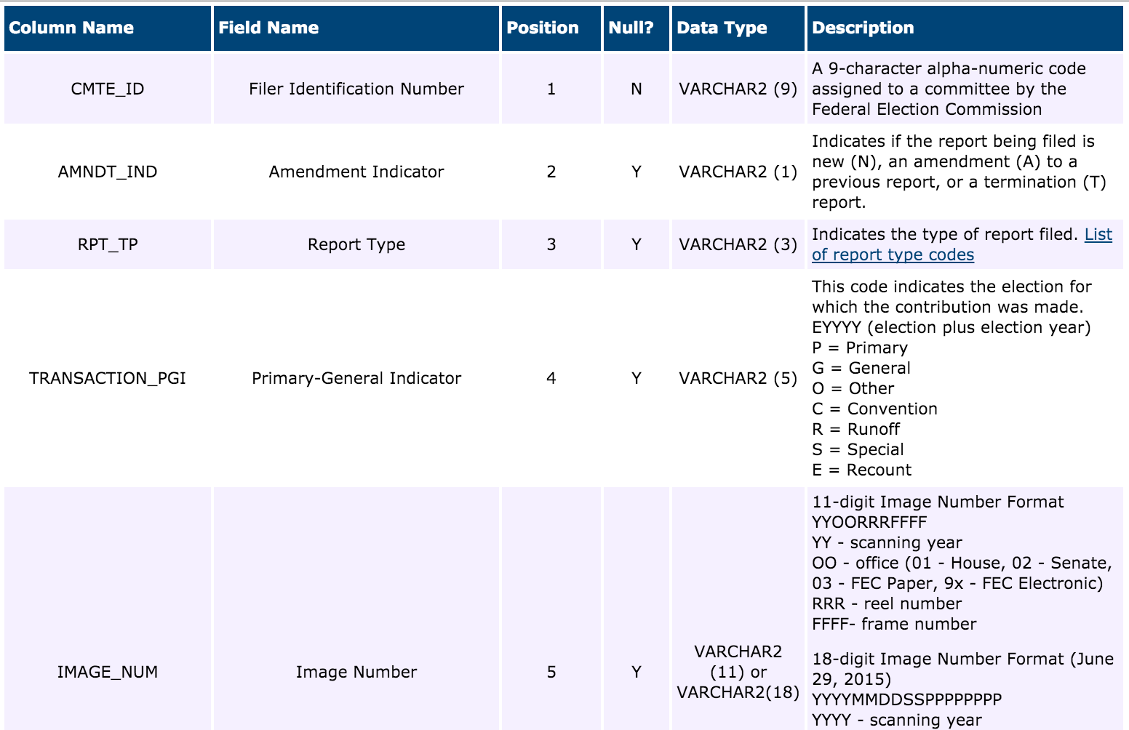
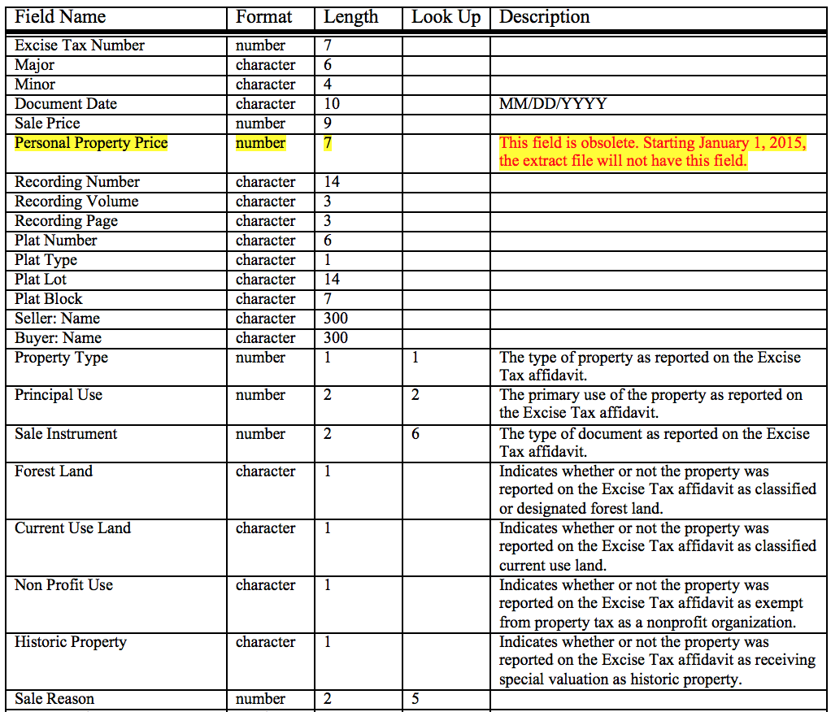
Understanding data schema
Variety of tools and “standards” for presentation, including tables & schema diagrams.

Slide 7
But…
There are two situations where a data summary doesn’t work:
There is no data summary
When you must really understand the data

Slide 8
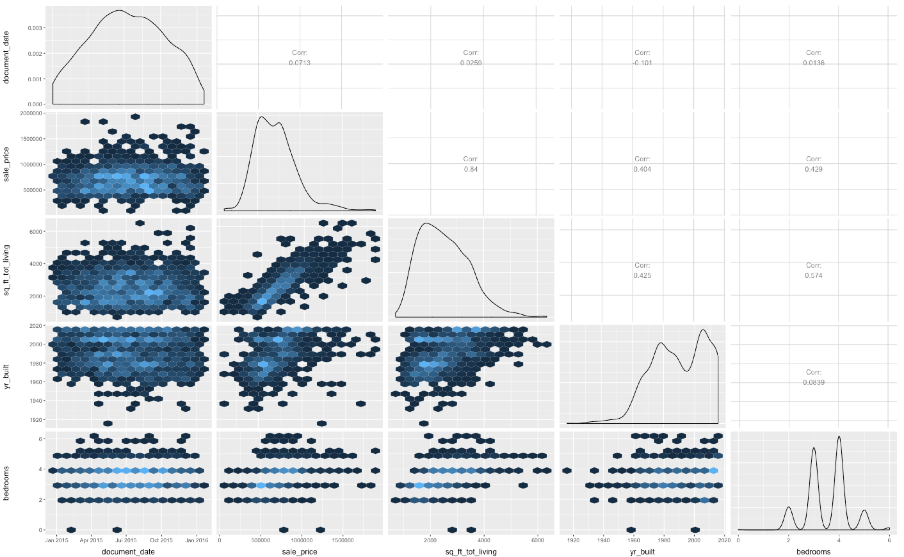
Exploring data sets & data profiling
To really understand, we explore and profile…

Slide 9
Data exploration is hard
Raw data requires more exploration than aggregate data. But can also offer greater insights.
As you saw last week (OpenRefine), software struggles with this challenge.
Humans are good at it, with time & practice.
To excel* at data exploration is to excel at data visualization
*sorry

Slide 10
Understand the data
Understand data types
Figure out the limits of the data:
min/max/other stats
unique values and counts
qualitative vs quantitative
geographic bounds
date and time range
Help with data prep & cleansing
Make analysis easier and faster
Find and present valuable insights

Slide 11
Understand the data
Counts
How much data do you have?
Are there missing data points that are important?
Qualitative vs quantitative
Are the values numeric, or text?
Sometimes numbers are more qualitative, sometimes text, quantitative.
Minimum & maximum
Won’t always help with outliers since it only shows a single value.
Assuming it’s good data, it can be very interesting.
Sum, average, median
Can help you understand, might even be a reportable metric
Geographic data
Shapes, latitude, and longitude.
Requires a mapping solution. (Apparently there’s ESRI for Windows Office)
Dates and times
Usually longer timespans are better for understanding trends
Pay attention to “latency”. More current is almost always better.

Slide 12
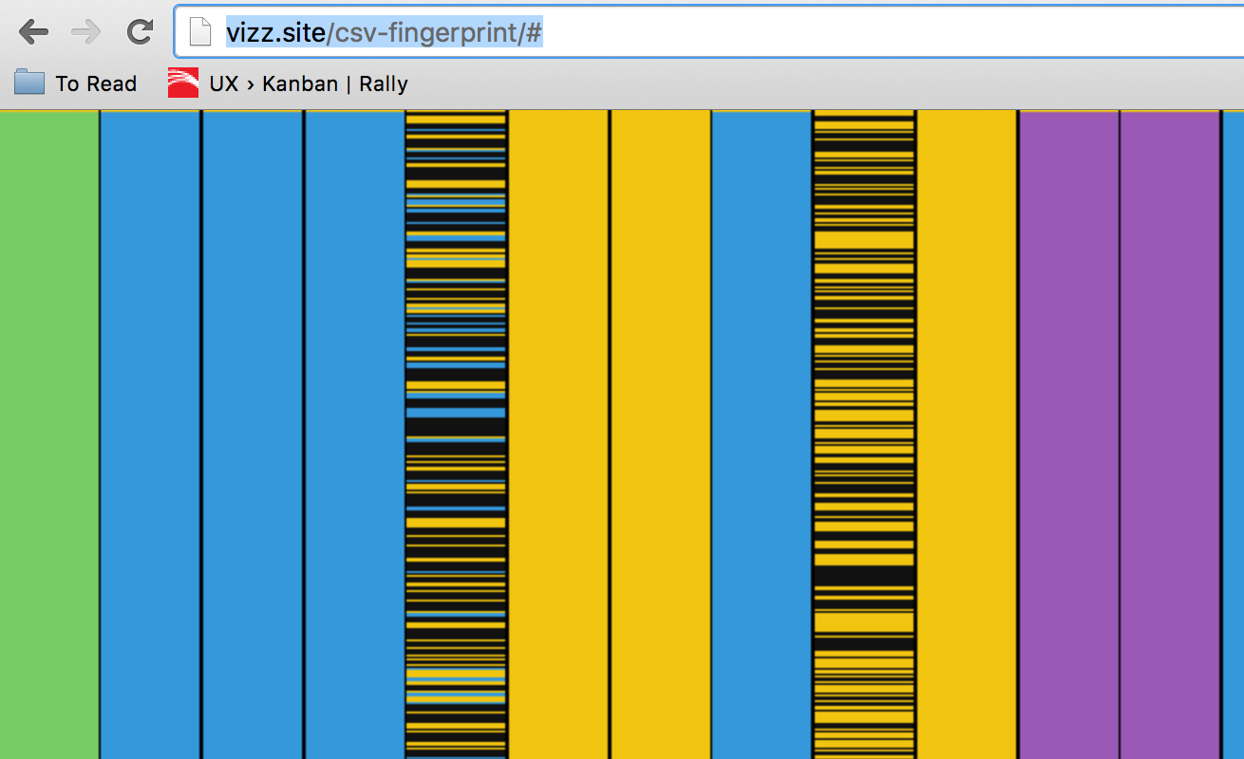
Exploring data types
A colorful look at CSV data
Demo: http://vizz.site/csv-fingerprint/
Source: https://github.com/setosa/csv-fingerprint
(as usual, I found more good visualizations from the creator: http://setosa.io/)

Slide 13
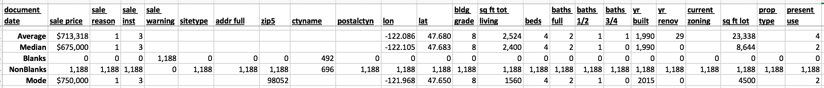
Summarizing data with Excel
Count of cells with values and blanks
Averages, medians, etc
Mode (but note it only works with numbers)
When it’s a string (or number) with limited variety of values… pivot

Slide 14
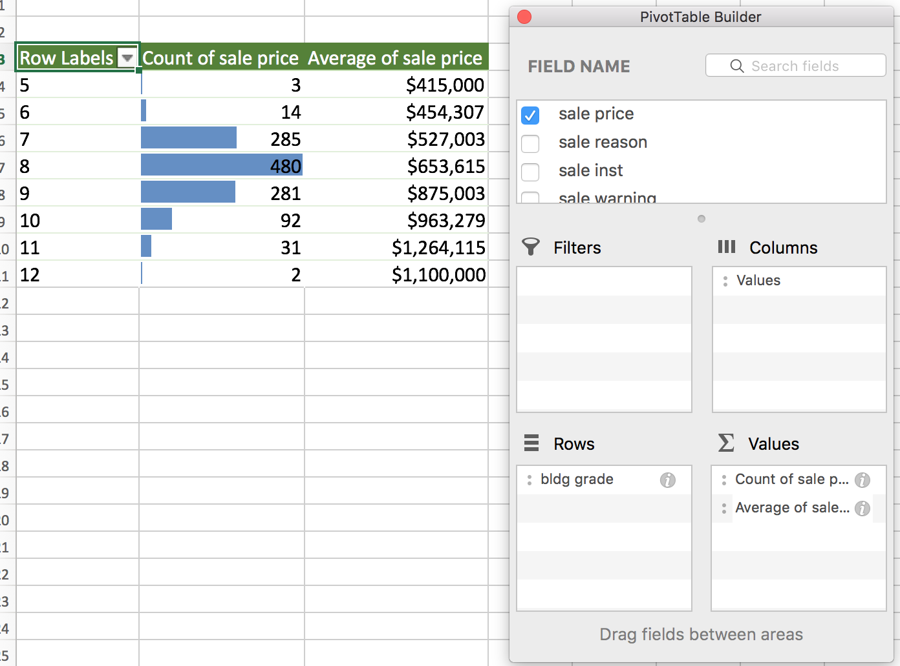
A few unique values with Excel
Use Pivot Tables
Show the count
Add conditional formatting
Add average sale price

Slide 15
Comparing a lot of values in Excel
”A lot” of numbers, also known as a continuous distribution
Excel is not very good at this… but you can scatter plot

Slide 16
Comparing a lot of values in R
http://www.rforexcelusers.com/book/data-frames/inspect-data-frame/
df[rows, colums]
head()
tail()
names()
summary()
str()
nrow()
dim()
for individual columns
unique()
table() for individual or combination of columns
head()
str()
summary()
length()
visualization
hist()
plot()
pairs()

Slide 17
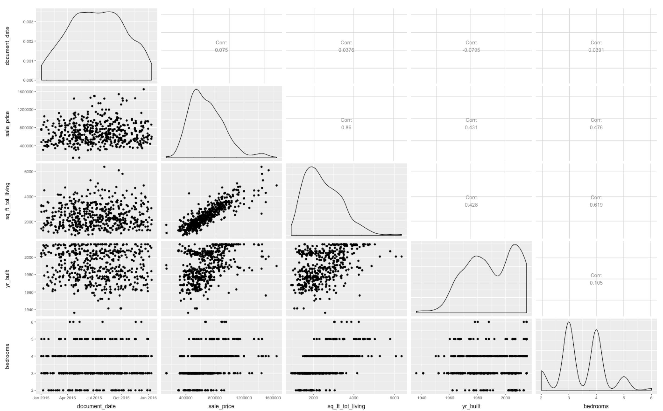
Comparing a lot of values in R

Slide 18
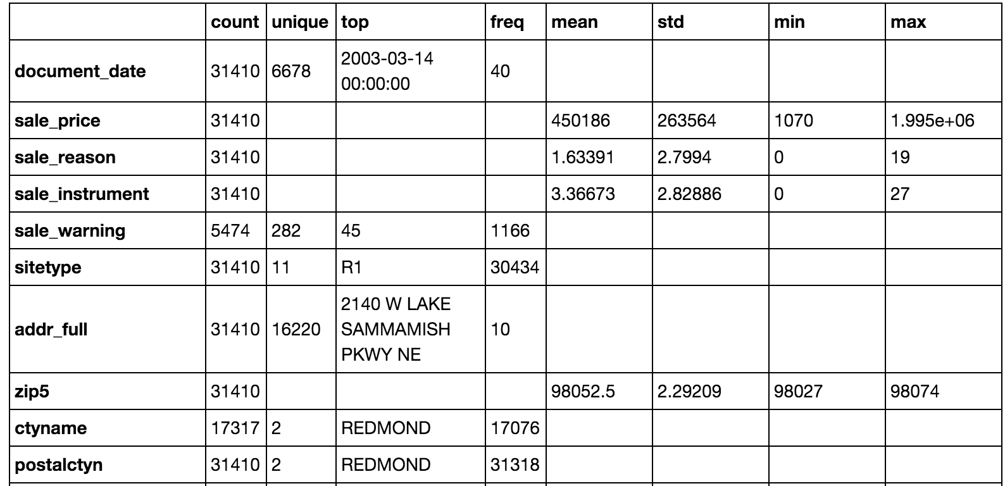
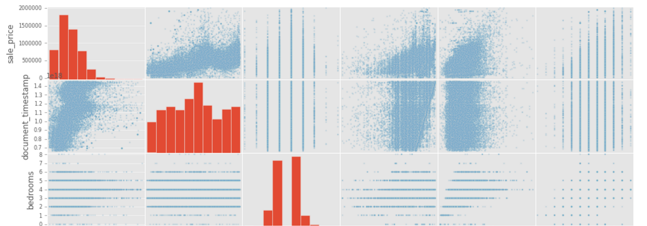
Comparing a lot of values in iPython
http://vizz.site:8000/

Slide 19
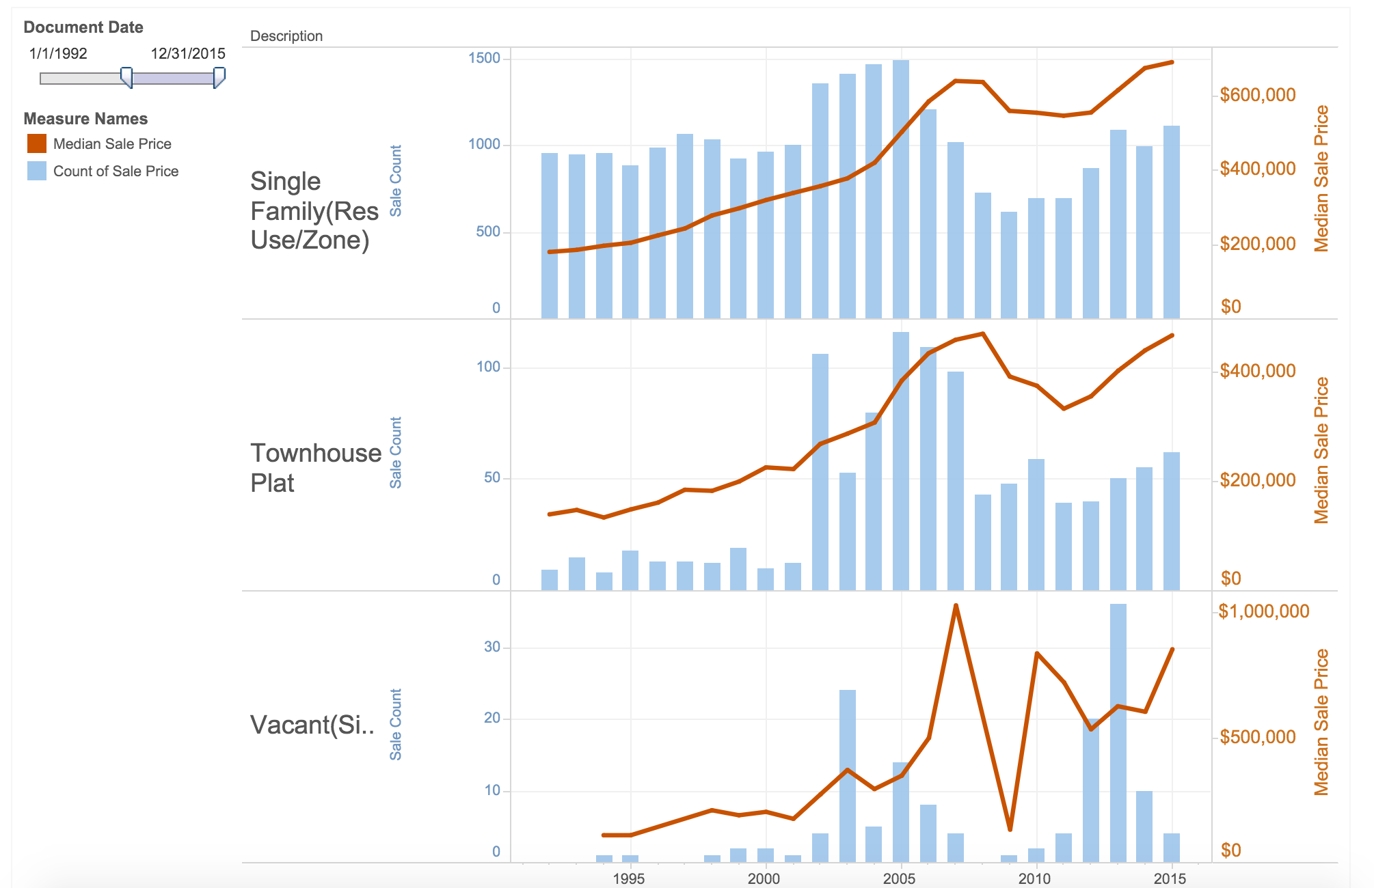
Comparing a lot of values in Tableau
https://public.tableau.com/profile/tommy.unger#!/vizhome/RedmondWAHomeSalesBreakdown/BreakdownbyHomeType

Slide 20
Homework: Profile FEC Donation data.
The FEC (Federal Election Commission) has a very robust data set: http://www.fec.gov/finance/disclosure/ftpdet.shtml#a2015_2016 (Links to an external site.)
For your convenience, I've compiled the 2015 (and a bit of 2016) data, by state, as well as all data combined in a single zip file here: http://vizz.site/fec-data/ (Links to an external site.)
Assignment
Required: Visualize the most common donation amounts in Washington state. Histogram is a great start, but maybe try something else. Use Tableau, Excel, R, or Python. Submit your answer as a public URL or attached file. Summarize your findings with a sentence or two.
Bonus: What is the most common donation amount in each state, and how do the states vary?
Double bonus: Visualize something else interesting

